Slide 1
Audio Mood Visualizer
(Automatic Speech Emotion Visualization Through Avatars)
Dr. Hanan Hindy
A.L. Yomna Ahmed

Slide 2
Omnia Ahmed
Team Members
Alaa Salah
Amany Elsayed
Nourhan Adel
Mai Adel
Nour Elhoda Ahmed

Slide 3
Table of contents
01
02
03
04
Introduction
Problem definition & motivavtion
objectives
System architecture
05
06
Datasets
Phases description
07
08
Experiments & results
Demo
09
Conclusion & Future work

Slide 4
“When dealing with people,
remember you are not dealing with
creatures of logic, but creatures of
emotions.”
Dale Carnegie

Slide 5
Introduction

Slide 6


Introduction
Speech is a complex signal that carries a wealth of information about the speakers, their language, the content of their message, and their emotional state. It is the most natural way for humans to express themselves, and when we are forced to use other forms of communication such as text messages or emails, we become acutely aware of its importance. But then we want to protect our privacy.
Speech emotion recognition is the identification of emotional states. So, we used it in our application that visualizes the emotions of the speaking person through the generation of a selected avatar that reflects the emotion detected from speech.

Slide 7
Problem Definition & Motivation

Slide 8

Problem Definition & Motivation
Our aim in this project is to develop a system capable of accurately detecting and classifying human emotions from audio signals. Emotions are inherently subjective and ambiguous, making it difficult to define clear boundaries between different emotional states.

Slide 9
Problem Definition & Motivation
Our main motivation was to train an efficient model that detects emotions from voice and visualizes these emotions through an avatar. Such an application can be utilized in many fields:
Medical field: can help people who have social phobias to communicate easily with others.
Games: Deliver a virtual reflection of a player’s emotions while protecting their privacy.
Customer service: can aid the call center workers.
E-learning and virtual meetings: help teachers to detect the emotional state of the students throughout the sessions.
Supports privacy: You can use a photo that isn't yours or by using a default avatar.

Slide 10
Objectives

Slide 11
Objectives
Apply recent advances in speech emotion recognition research.
Visualize the recognized emotions (Happy, Sad, Fearful, Calm, Angry) through the generation of avatars with facial expressions that correspond to the detected emotion.
Create an application where the user could communicate with people and all his/her emotions are delivered to them through an avatar without needing to open the camera.
Experiment with additional features to further personalize the avatars while preserving the identity of the original speaker.

Slide 12
System Architecture

Slide 13
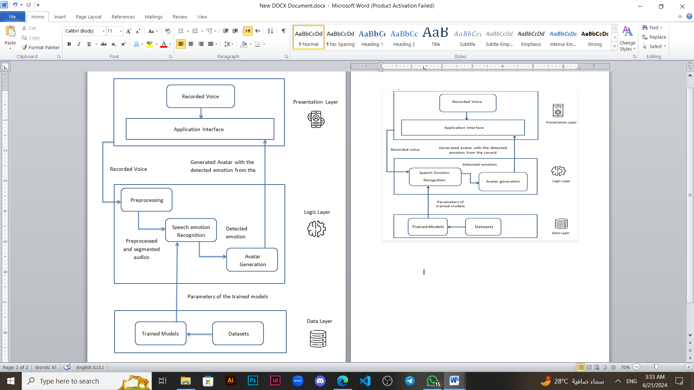

Slide 14
Datasets

Slide 15

)RAVDESS Dataset ( :
Full dataset of speech and song, audio and video. It contains :
24 professional actors (12 female, 12 male).
Speech emotions include (calm, happy, sad, angry, fearful, surprise,
natural and disgust) expressions.
Each expression is produced at two levels of emotional intensity
(normal, strong), with an additional neutral expression.
Dataset Sample
Training | Validation | Testing
1152 | 144 | 144

Slide 16
Phases Description

Slide 17
02
04
01
03
Preprocessing
Phases Description
Feature Extraction
Avatar Generation
Speech Emotion Recognition

Slide 18

1. Preprocessing
Extract waveforms from dataset
Divide data into train, validation, and test
Applying data augmentation on training through AWGN (Additive white gaussian noise)
Apply normalization on data to reduce training time
Audio with noise
Audio without noise

Slide 19
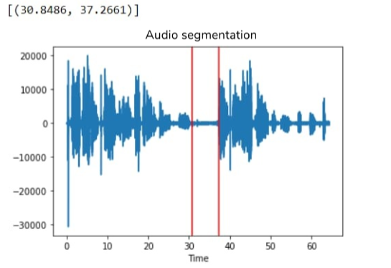
1. Preprocessing
Audio Segmentation :
As the dataset contains audios of one sentence, we applied segmentation so we could split the test audio (if it’s longer than one sentence) into sentences.
The audio is preprocessed before sending it to the speech emotion recognition module. We split audio into small audio segments according to silence. Then remove noise from audio. Then detect emotions from audios according to MFCC.

Slide 20
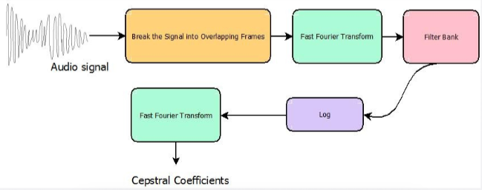
2. Feature Extraction
MFCCs was used for features extraction.
MFCCs are a set of coefficients that capture the spectral characteristics of an audio signal.

Slide 21
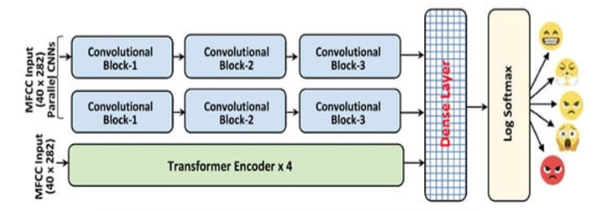
3. Speech Emotion Recognition
It contains two parallel CNN model and multi-head attention transformer encoder to recognize emotions in speech spectrograms from audio

Slide 22
3. Speech Emotion Recognition
Transformer block includes :-
number of transformer encoder layer=4.
Each transformer encoder layer contains:-
Self-attention heads (4).
Dropout(0.4).
Activation function(Relu).
Each convolution block includes :-
2D convolution layer.
Batch normalizes.
Activation function(Relu).
Max_pooling 2D.
Dropout(0.3).
Fully connected dense network and SoftMax activation function for emotion state prediction.

Slide 23

4. Avatar Generagtion
We created avatars by taking the emotions detected from the previous phase and created the suitable combinations of attributes such as : eyebrows, eyes, mouth, ....etc to get the suitable emotional avatar.
Then we send these combinations to python_avatar library to generate the desired emotional avatar.
It has many attributes such as :
style, background_color, eyes.
top, eyebrows, nose, facial_hair,
hair_color, accessory, clothing,
clothing_color, mouth.

Slide 24


4. Avatar Generagtion
We created 2 copies of the emotional avatar :
- one with closed mouth
- one with opened mouth
, so that it would give the sense of speaking.
To create the video, all emotions detected in the audio are put in an array and displayed along with the audio.

Slide 25
Experiments & Results

Slide 26
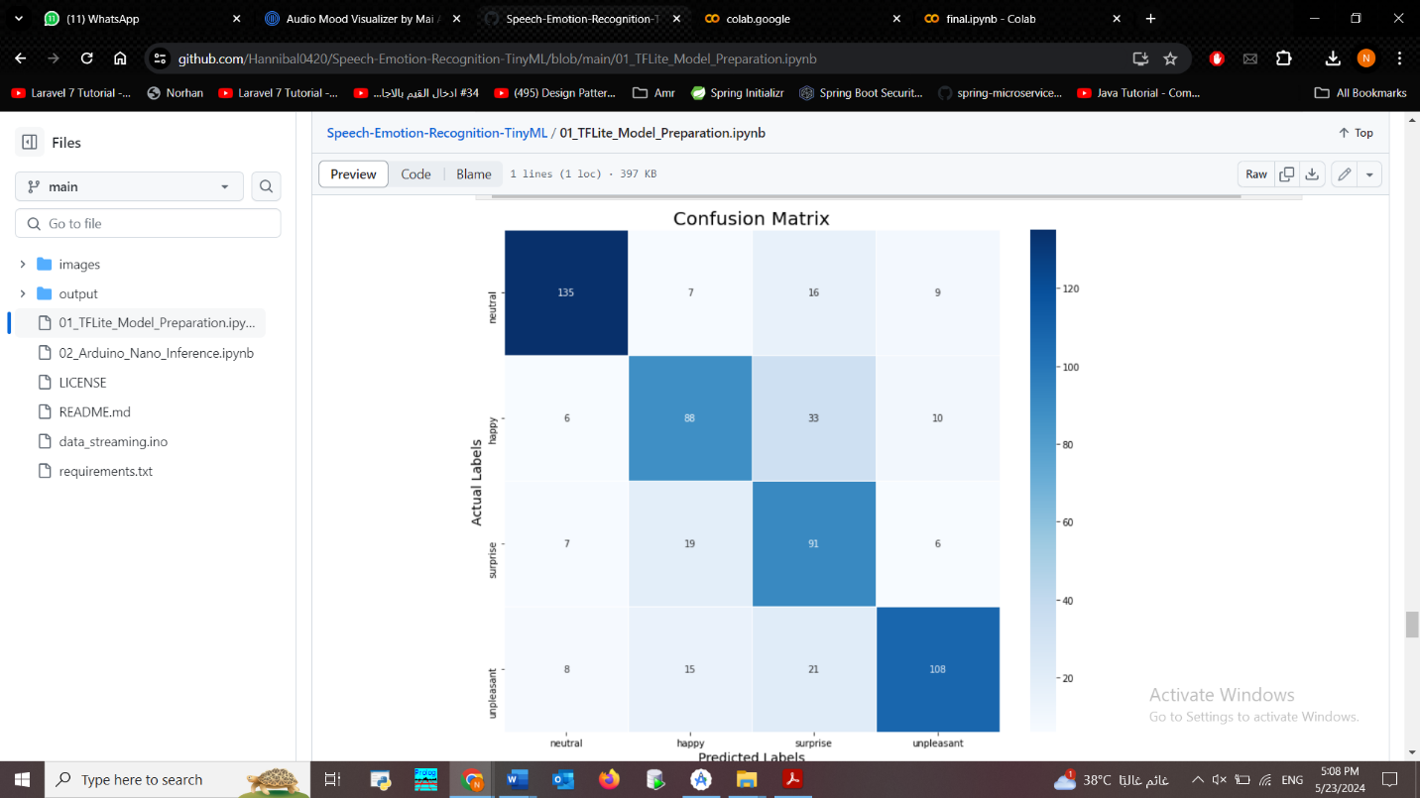
Experiments & Results
1- LSTM:
Preprocessing :
We used 8 classes instead of 4 classes.
Trials :
Architecture:
1st Trial | 2nd Trial
Added a convolutional layer Followed by Batch Normalization layer. | Increased number of LSTM layers from 2 to3.
76% | 89%

Slide 27
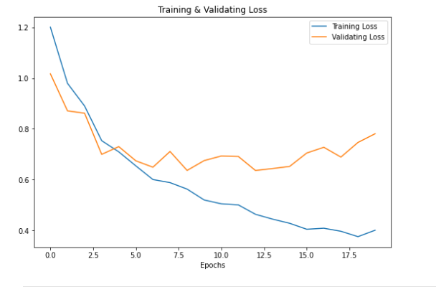
Experiments & Results
Dataset : RAVDESS.
Number of epochs : 500.
We observed that the neutral and unpleasant emotions were the best emotions the model could predict.

Slide 28
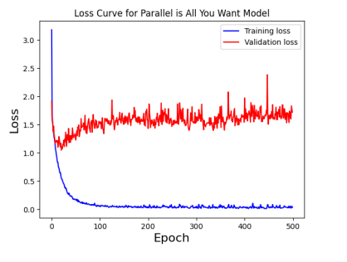
Experiments & Results
2- CNN & multi head transformer model :
Dataset : RAVDESS.
Number of epochs : 500.
Trials :
Feature Extraction :-
Mel-spectrogram | MFCC
Added a convolutional layer Followed by Batch Normalization layer. | Increased number of LSTM layers from 2 to3.
75% | 95%

Slide 29
Experiments & Results
Architecture :-
1st Trial | 2nd Trial | 3rd Trial | 4th Trial
In transformer encoder block: We changed the number of layers from 4 to 6. | In two convolution blocks : We changed Max_pooling to Avarege_pooling. | Used Transformer encoder only. | Used normalization layer instead of batch normalization
Accuracy 76%. | Accuracy 74%. | Accuracy 78% | Accuracy 82%

Slide 30
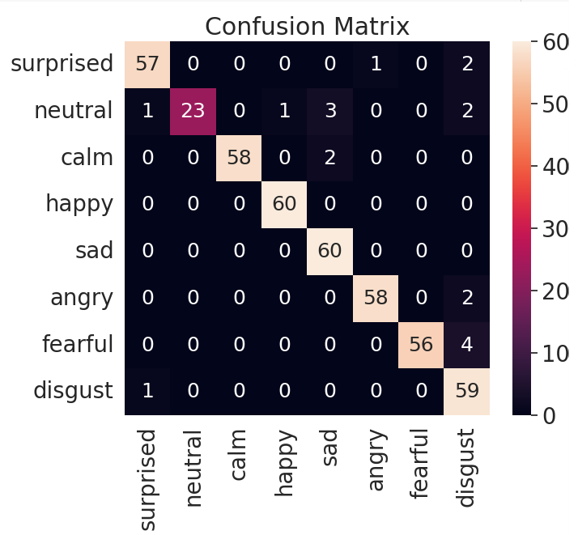
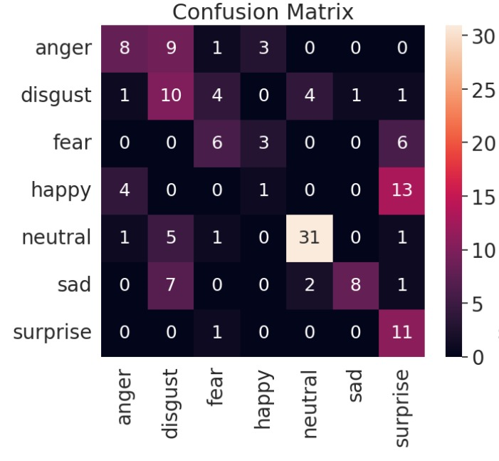
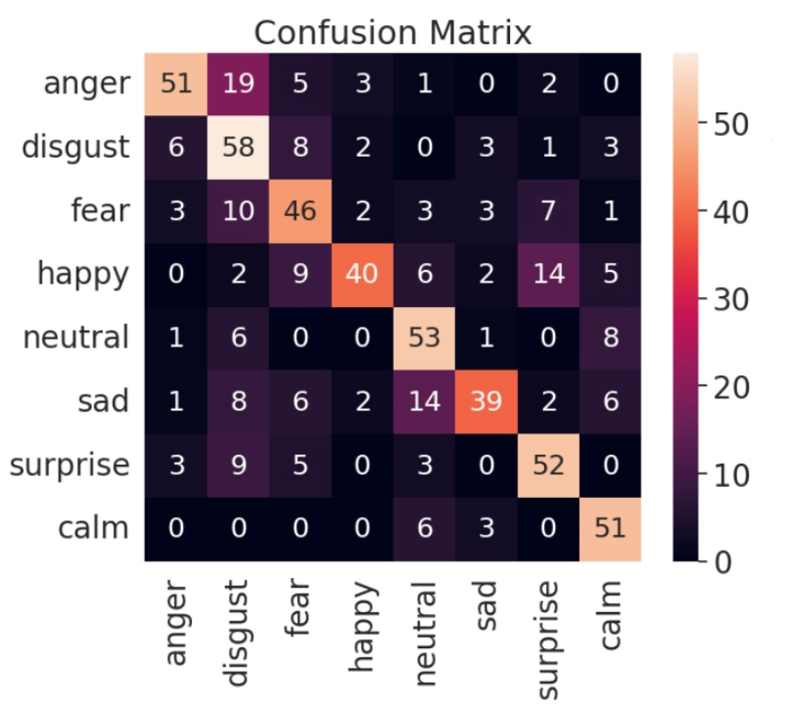
Experiments & Results
Datasets :-
1st Trial | 2nd Trial | 3rd Trial
RAVDESS | SAVEE | RAVDESS + SAVEE
Accuracy 95%. | Accuracy 62.5%. | Accuracy 72.7%.

Slide 31
Demo

Slide 32


Demo
Female Demo
Male Demo

Slide 33
Conclusion & Future Work

Slide 34
Conclusion
We observed that the model best detects the distinct emotions of “angry” and “sad” and could not differentiate between “calm” and “neutral” emotions as they are close to each other in the voice tone. we created 2 copies of each avatar (one with opened mouth and one with closed one) so we can imitate the visualization of speaking. Finally, a video of the set of the generated avatars was created.
LSTM model:
1st Trial | 2nd Trial
Added a convolutional layer Followed by Batch Normalization layer. | Increased number of LSTM layers from 2 to3.
76% | 89%
So, Increased number of LSTM layers from 2 to3 is our main model.

Slide 35
Conclusion
CNN & multi-head transformer model:
Trial | Accuracy | Conclusion
Mel-spectrogram | 75% | Using MFCC as our main feature.
MFCC | 95%
SAVEE | 62.5% | Using RAVDESS as our main dataset.
RAVDESS + SAVEE | 72.5%
RAVDESS | 95%
In CNN: Changed Max_pooling to avarege_pooling. | 74% | Using batch normalization layer as our main model.
In transformer encoder block: the number of layers has been changed from 4 to 6. | 76%

Slide 36
Conclusion
CNN & multi-head transformer model:
Trial | Accuracy | Conclusion
Used transformer encoder only | 78% | Using batch normalization layer as our main model.
Used normalization layer instead of batch normalization | 82%
Used batch normalization | 95%

Slide 37
Future Work
Possible venues for future work include:
Avatar personalization while preserving the identity of the original speaker and the addition of lip-syncing using deep fake technologies without the reliance on camera footage.
2. Visualizing the emotions of multiple users at the same time
3. Improving the accuracy of detection of the calm and the natural emotions for
better differentiation between them.
4. Work on minimizing response time of the API.

Slide 38
Thank you

